Slide 1
Skeena Region
2022 DAOS Summary
By Benjamin Timmerman

Slide 2
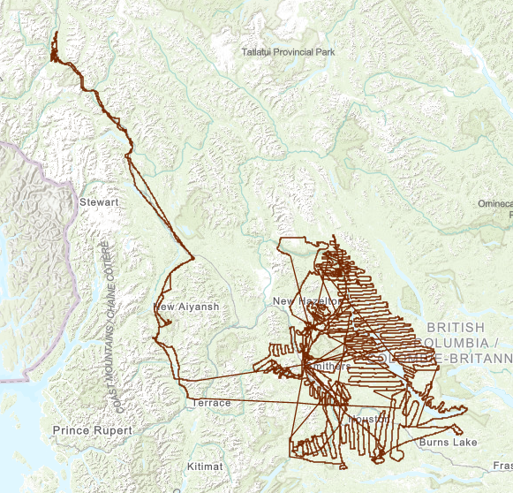
Detailed Aerial overview Survey
Helicopter survey mapping waypoints and areas of bark beetle infestation.
Limited to identifying ‘red attack’ stage bark beetle infestations.
Management tactics assigned to each infestation node and polygon.

Slide 3
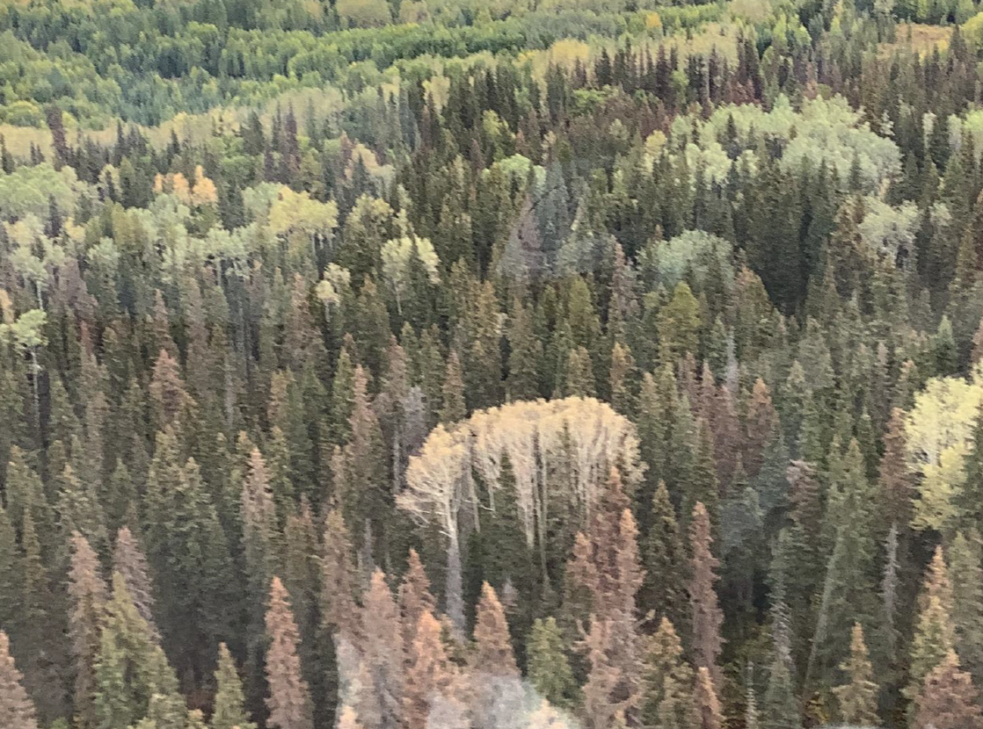
Detailed Aerial overview Survey
Helicopter survey mapping waypoints and areas of bark beetle infestation.
Limited to identifying ‘red attack’ stage bark beetle infestations.
Management tactics assigned to each infestation node and polygon.

Slide 4
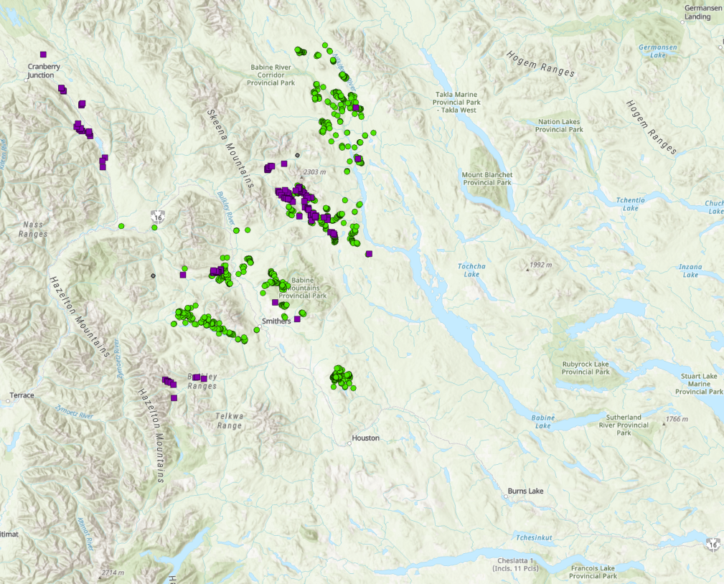

Infestation Spread 2016-2022
CUMULATIVE INFESTATION 2016

Slide 5
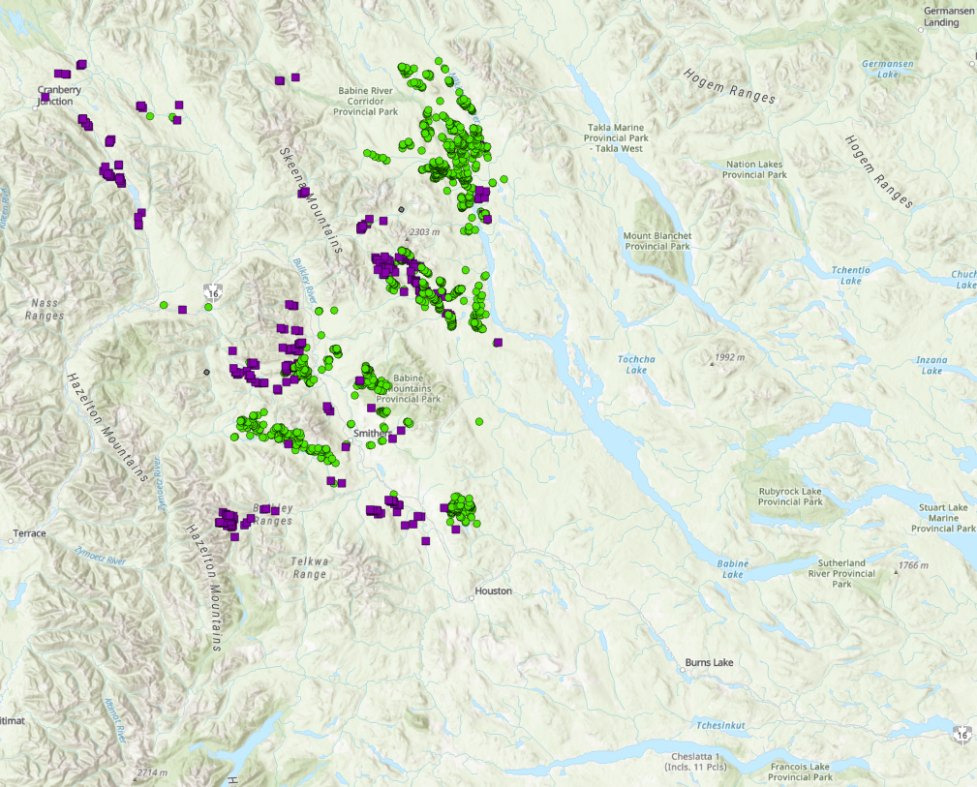
Infestation Spread 2016-2022
CUMULATIVE INFESTATION 2017

Slide 6
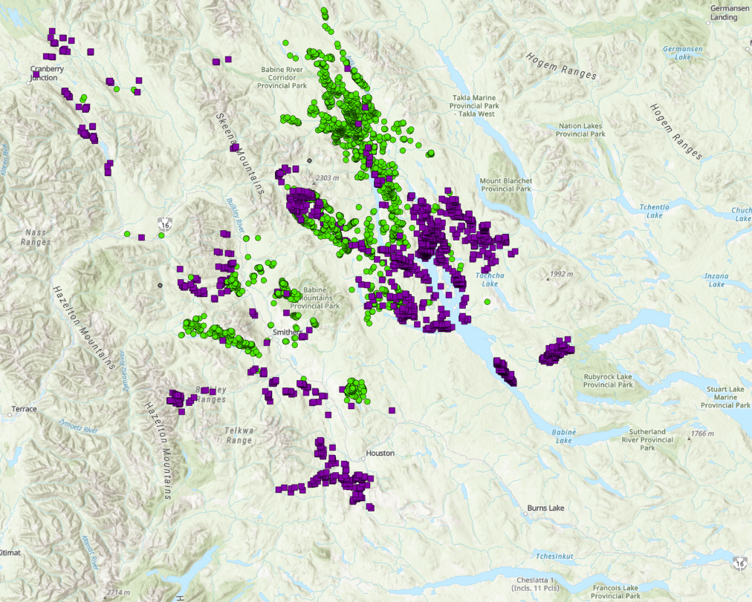
Infestation Spread 2016-2022
CUMULATIVE INFESTATION 2018

Slide 7
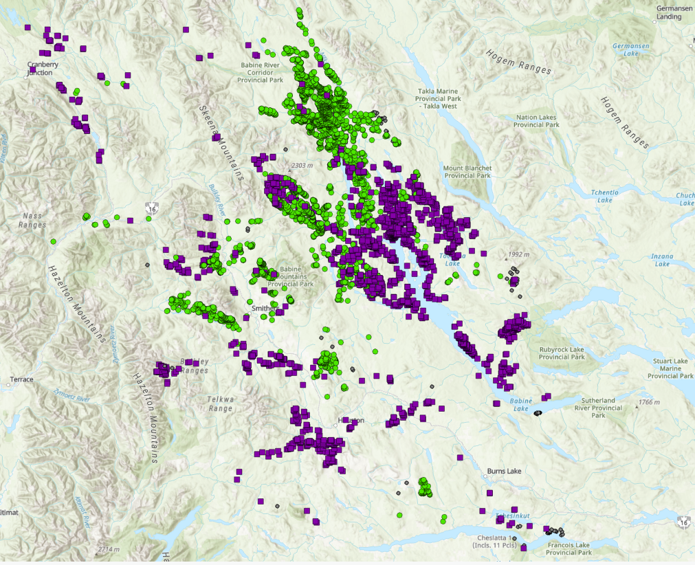
Infestation Spread 2016-2022
CUMULATIVE INFESTATION 2019

Slide 8
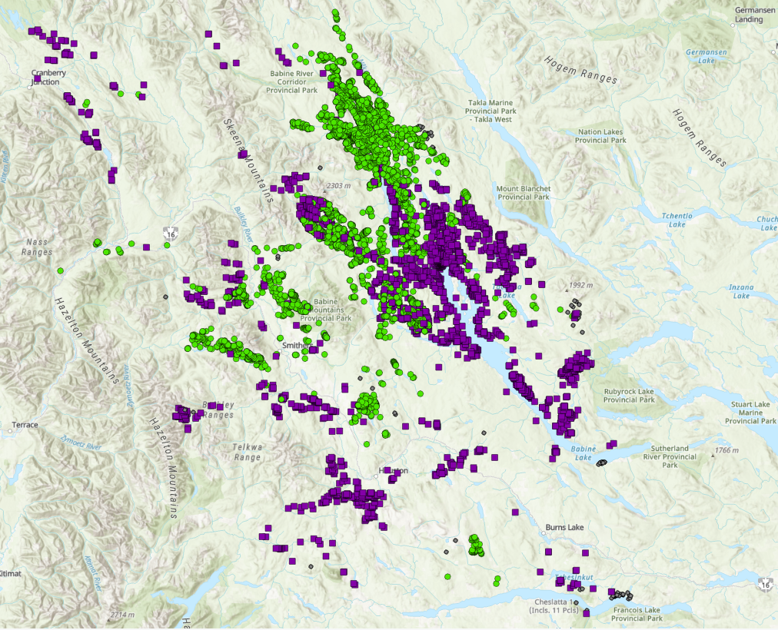
Infestation Spread 2016-2022
CUMULATIVE INFESTATION 2020

Slide 9
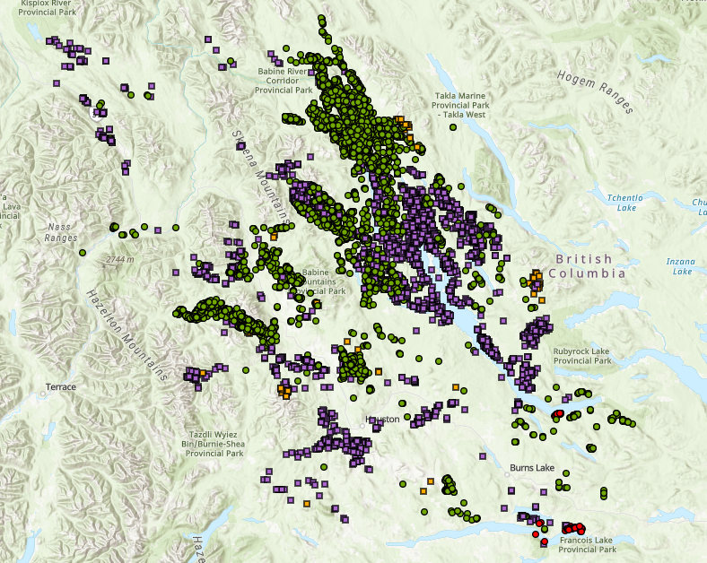
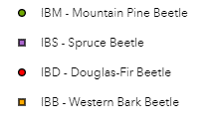
Infestation Spread 2016-2022
CUMULATIVE INFESTATION 2021

Slide 10
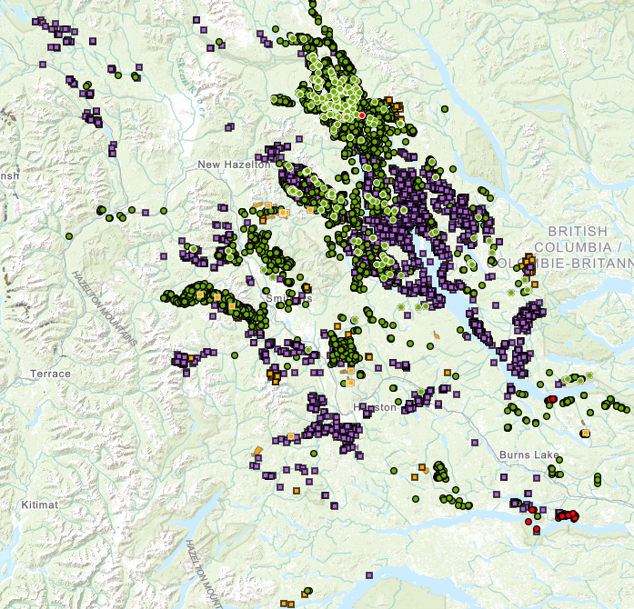
Infestation Spread 2016-2022
CUMULATIVE INFESTATION 2022

Slide 11
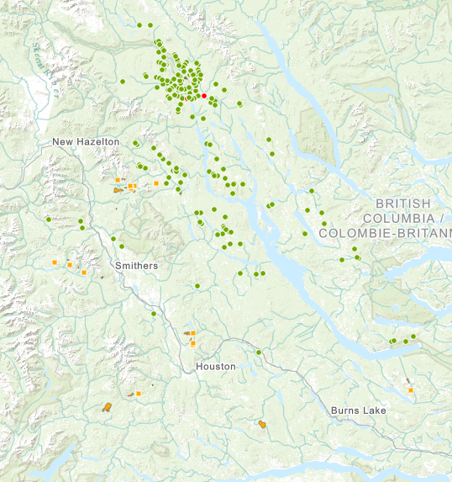
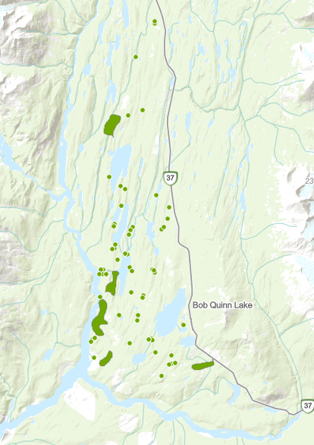
2022 Infestation points

Slide 12
Detailed Aerial overview Survey
DAOS Point Data (# of Reds) | IBD | IBM | IBS | All
2016 |  | 10081 | 5652 | 15733
2017 |  | 10291 | 10787 | 21078
2018 |  | 26040 | 36386 | 62426
2019 | 206 | 29888 | 31653 | 69037
2020 | 98 | 22468 | 13973 | 36539
2021 | 13 | 3685 | 222 | 3920
2022 | 6 | 2203 | 0 | 2335
2022 DAOS observations continue to illustrate a decline in infestation rates.
Cold snaps over last 3 years likely contributed to brood mortality.
The heat domes had a profound impact on larval mortality.

Slide 13
Detailed Aerial overview Survey
Count of DAOS Observations 2016-2022 | Obeserved
Year | #
2016 | 845
2017 | 956
2018 | 2971
2019 | 2869
2020 | 1689
2021 | 904
2022 | 438
Total observations down almost 50%
However, there were 38 polygons noted this year
IBB infestation across the region continues to rise.

Slide 14
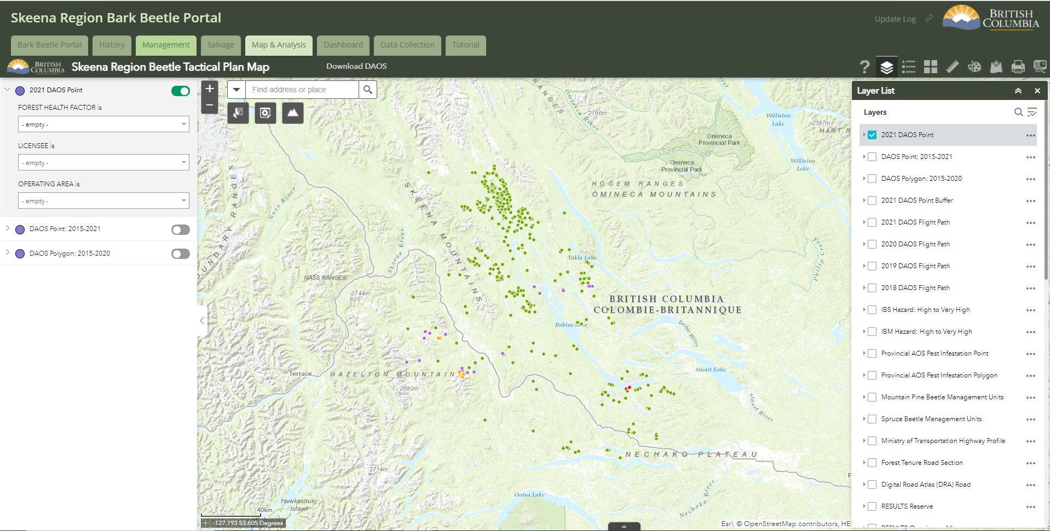
Skeena REGION BARK BEETLE PORTAL
Bark Beetle Portal -
Tool for coordinating and monitoring management activities within the region.

Slide 15
Bark Beetle Management Initiatives
IBB research plot development – shelf-life study, pheromone testing, and management techniques.
Regional based IBM Search and Destroy Contract.
Bark Beetle Dashboard tool being updated to provide bark beetle metrics for 2022 data.

Slide 16
Questions?
Contact me: Benjamin.Timmerman@gov.bc.ca
250-692-1286
Explore the portal!
https://governmentofbc.maps.arcgis.com/apps/MapSeries/index.html?appid=8ae73998dc914ceba50c6b2ad667564b#
Username: PX_OSBP
Password: guest123

